Slide 1

By UE2

Slide 2


Slide 3
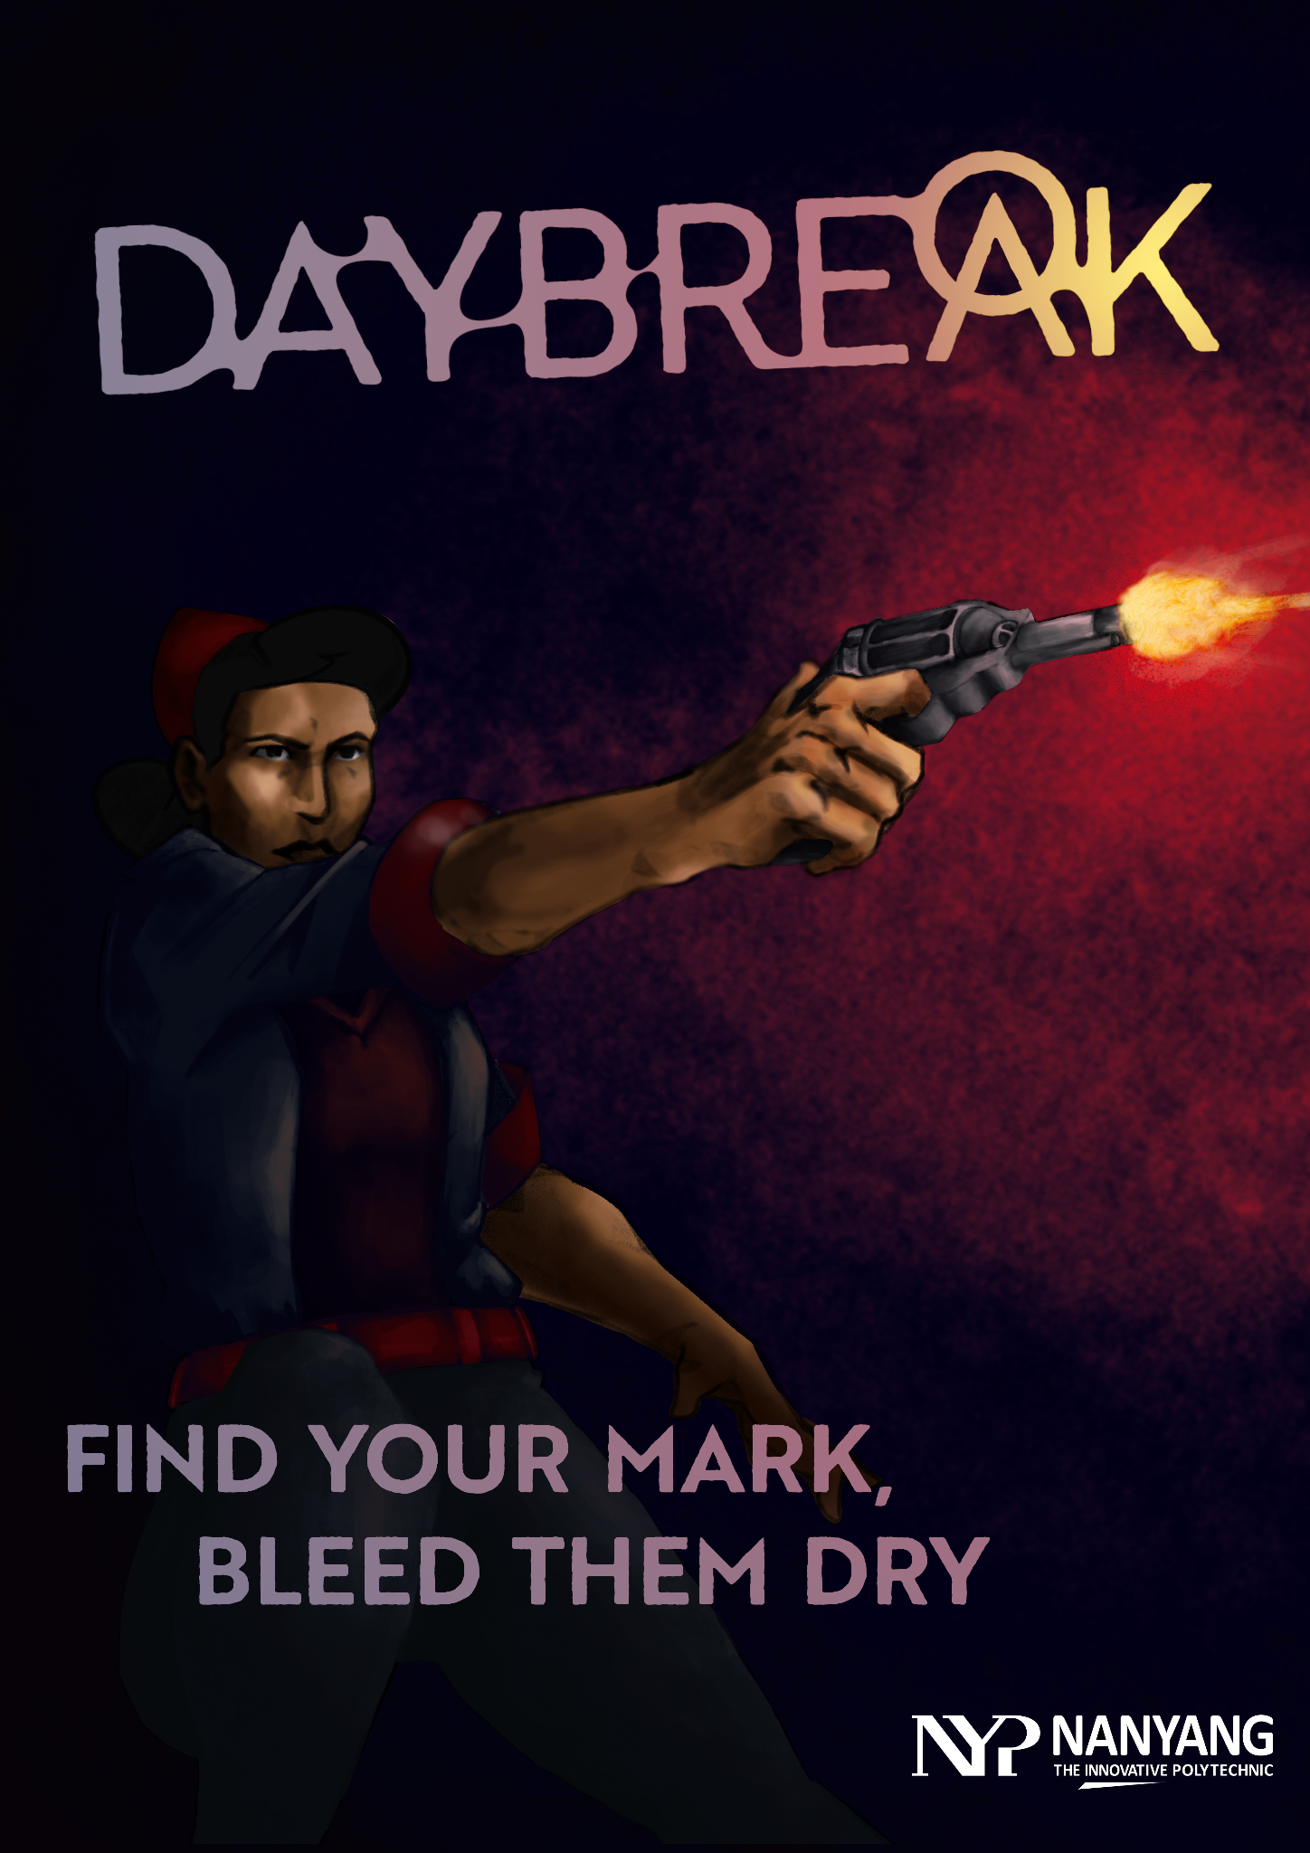
Game Story
Player controls the half-vampire Dorris, who plans to kill the boss of a vampire mafia for his involvement in the smuggling of Nostrum, a dangerous drug that turns people into vampires
She now has to infiltrate through the drug warehouse with the plan to assassinate the Don of the operation as stealthily as possible

Slide 4
Unique Selling Points
Stealth Game with Vampire-Inspired Abilities(Teleportation, X-Ray)
Stealth game with semi-destructible environment
Immersive play with lighting engine
Complex AI behaviour
Notes:
Realistic stealth capabilities, the player has to manage line of sight, loudness as well as visibility to avoid detection, or to distract enemies enough for them to ignore the player’s presence.
Fantasy vampire inspired abilities to aid the player
Stealth game with destructible environments, contrary to other stealth games where environment is solid and no flashy actions can destroy walls.
Immersive play on lighting engine, where the fog of war ebbs and flows to obscure the vision of the player
Complex AI behavior, they live their own lives and routines during the game’s time, where each of them has their own individual work and tasks as well as needs.

Slide 5
Game Mechanics - Final
Third Person Mode
Toggled By Zooming in the camera, changes game view from isometric to third person, when the revolver is equipped, a crosshair shows up on screen
Inventory
6 Slots Total, 1 Pre-assigned to rock, 1 to Empty Hand, 4 to item pickups
Press item icon to equip, press trash icon to drop the item
Objective HUD
Press Tab to open, displays stage objective.
A arrow will appear on screen to guide the player to the location of the objective

Slide 6
Game Mechanics(Interaction) - Final
Consumption
Press ‘F’ while not at full health, near a dead human
Stay still for 5 seconds while you consume the deceased to recover to full health
Dragging
Press ‘G’ near a dead enemy to drag them around
Used to drag Thrulls into the sunlight to incinerate them

Slide 7
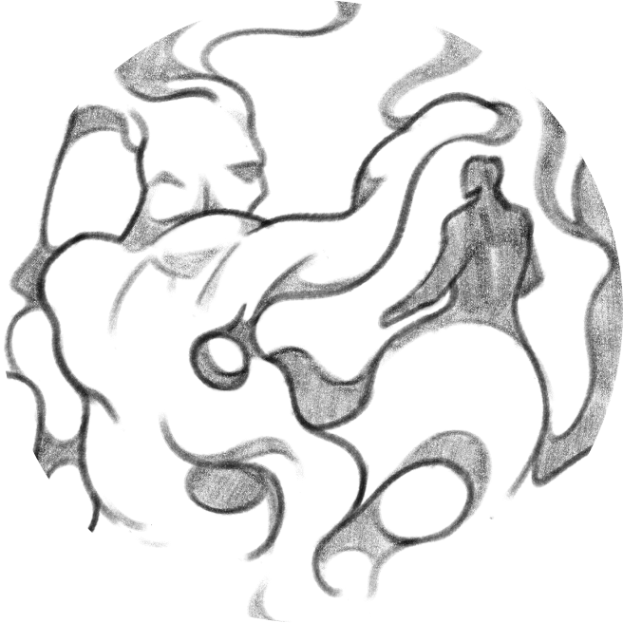
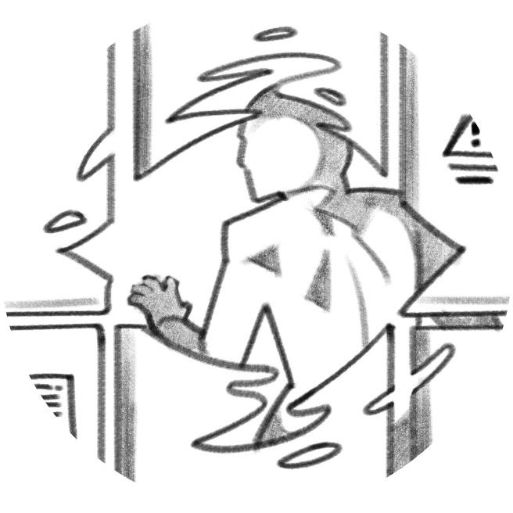
Game Mechanics(Abilities) - Final
Teleportation
Press ‘V’ when ability is not on cooldown to toggle the teleport state
Right Click around the player while in this state to channel and then teleport onto the clicked location
Vampire Sense
Press ‘X’ while ability is not on cooldown to temporarily be able to see specific things through walls (*Only through Solid Object).
Red for Enemy, Green for Item Pickup, Yellow for Objective

Slide 8
Known Bugs
Dragging doesn’t work with new enemy model
Falling can cause player to face and clip into the ground

Slide 9
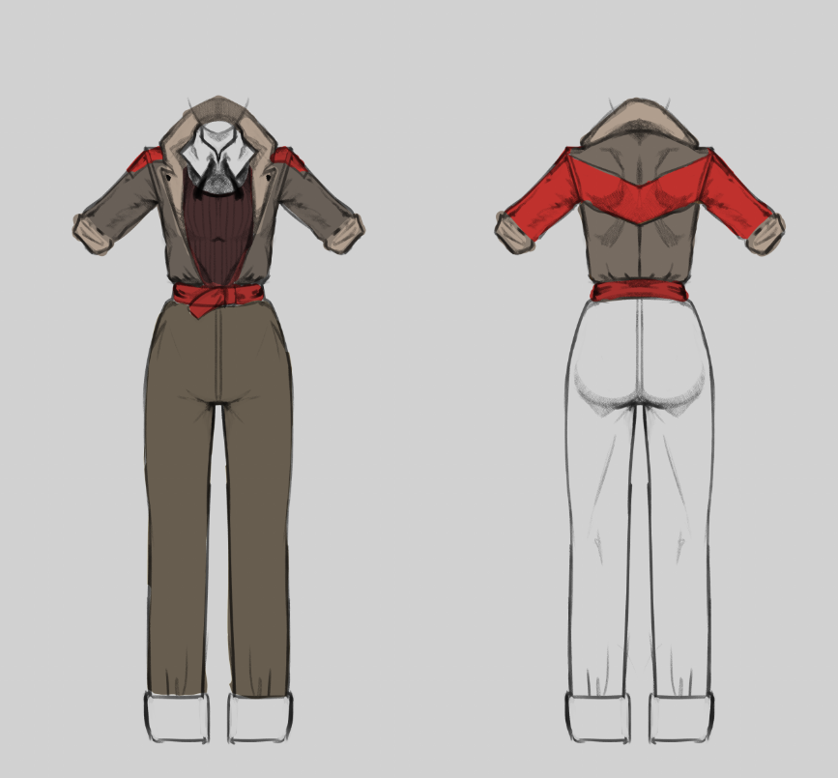
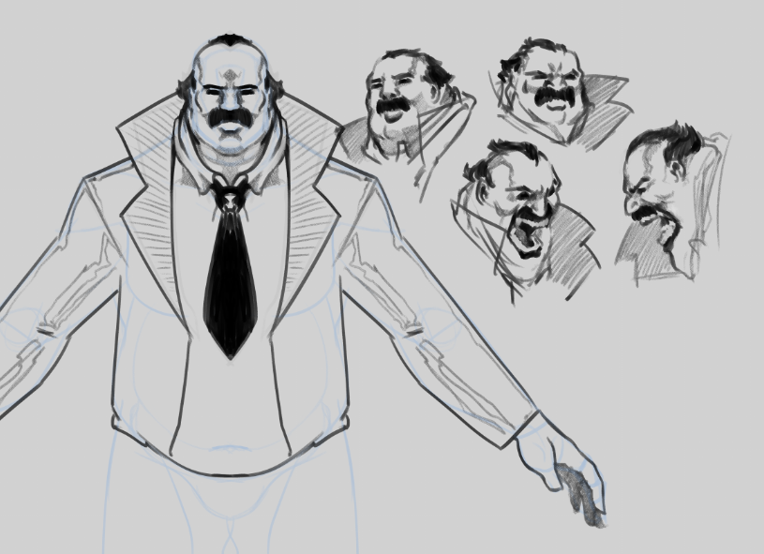
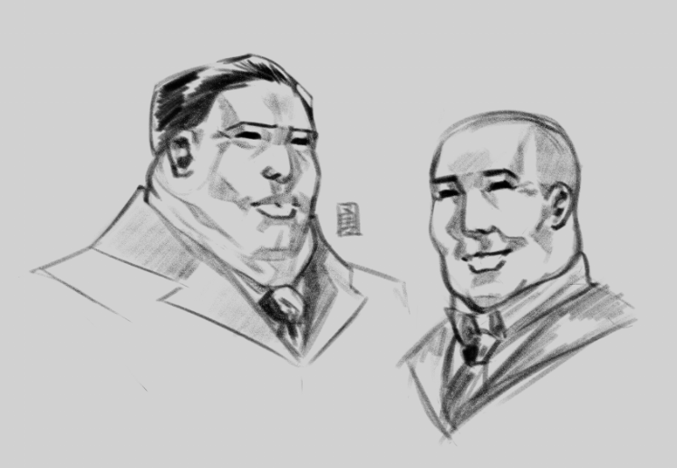
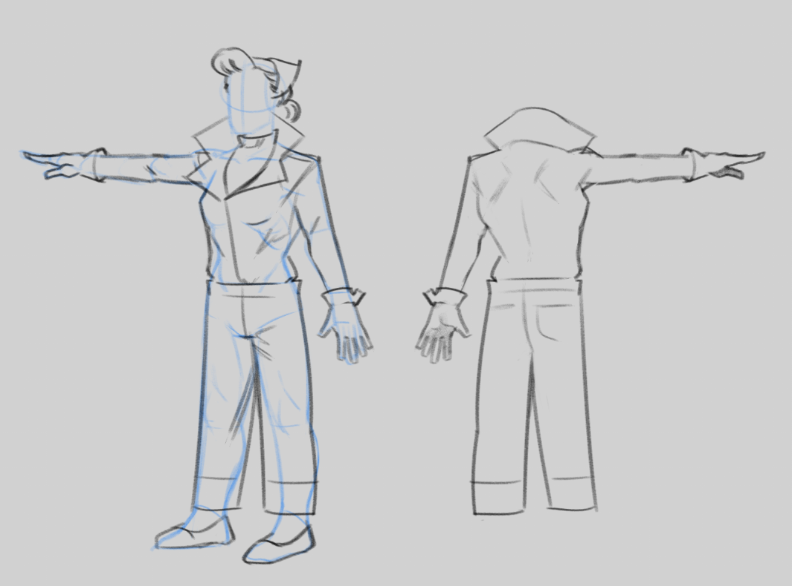
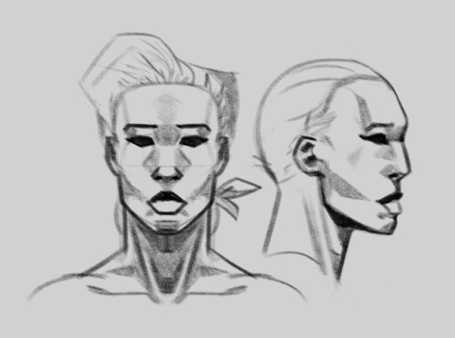
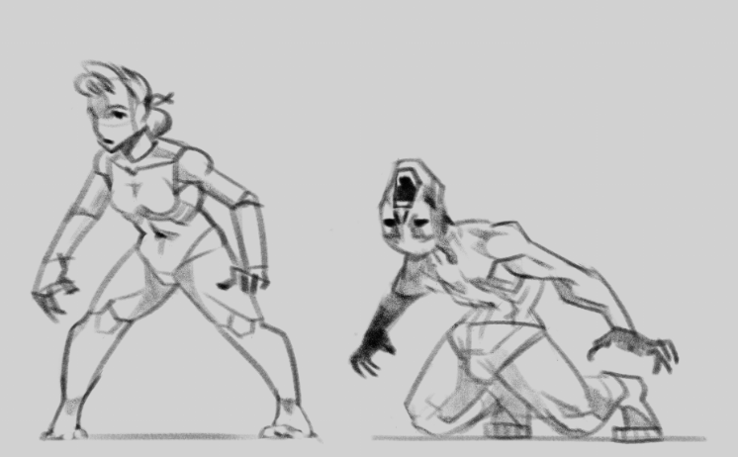
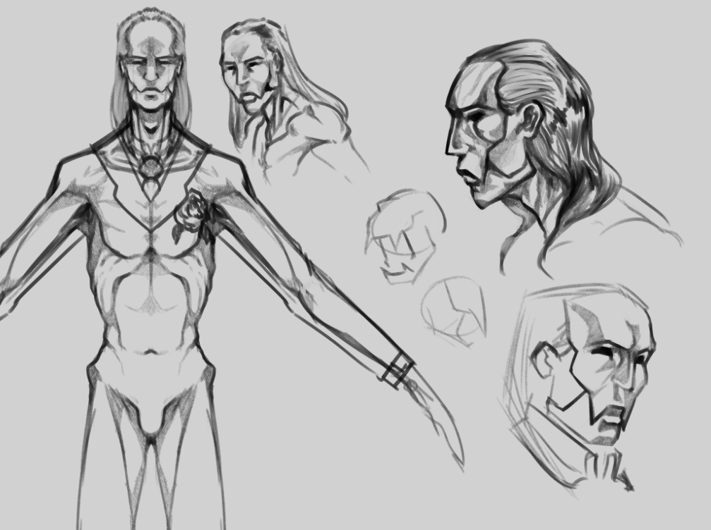
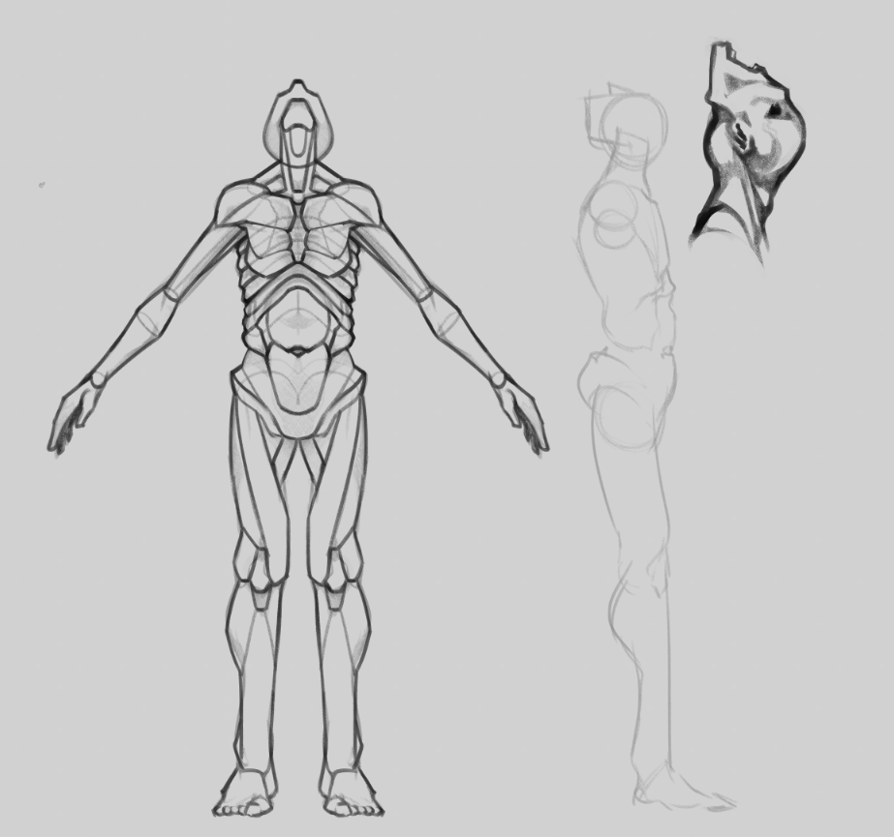
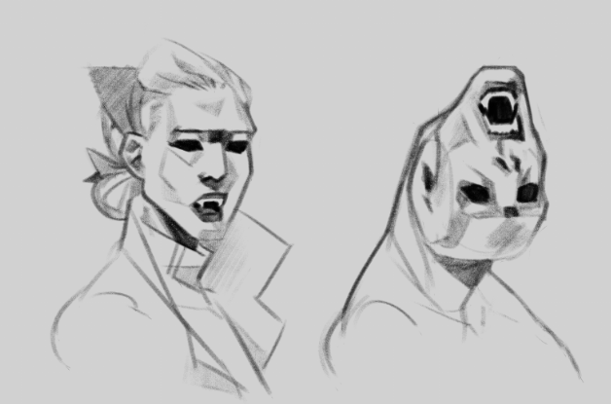
Concept Art

Slide 10
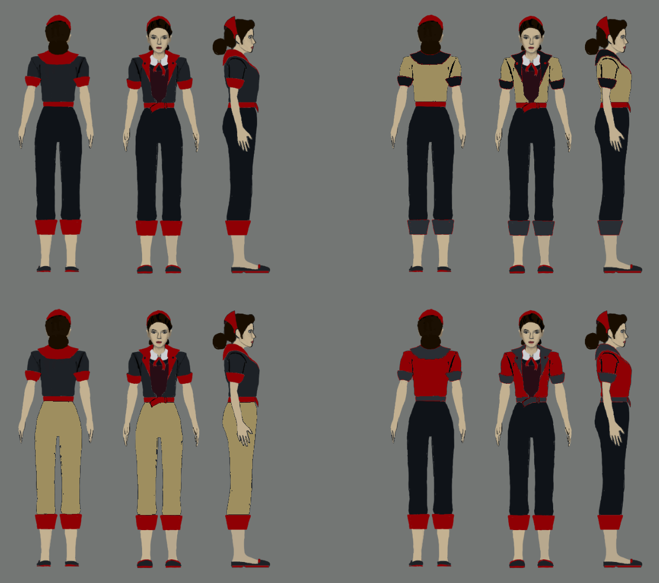
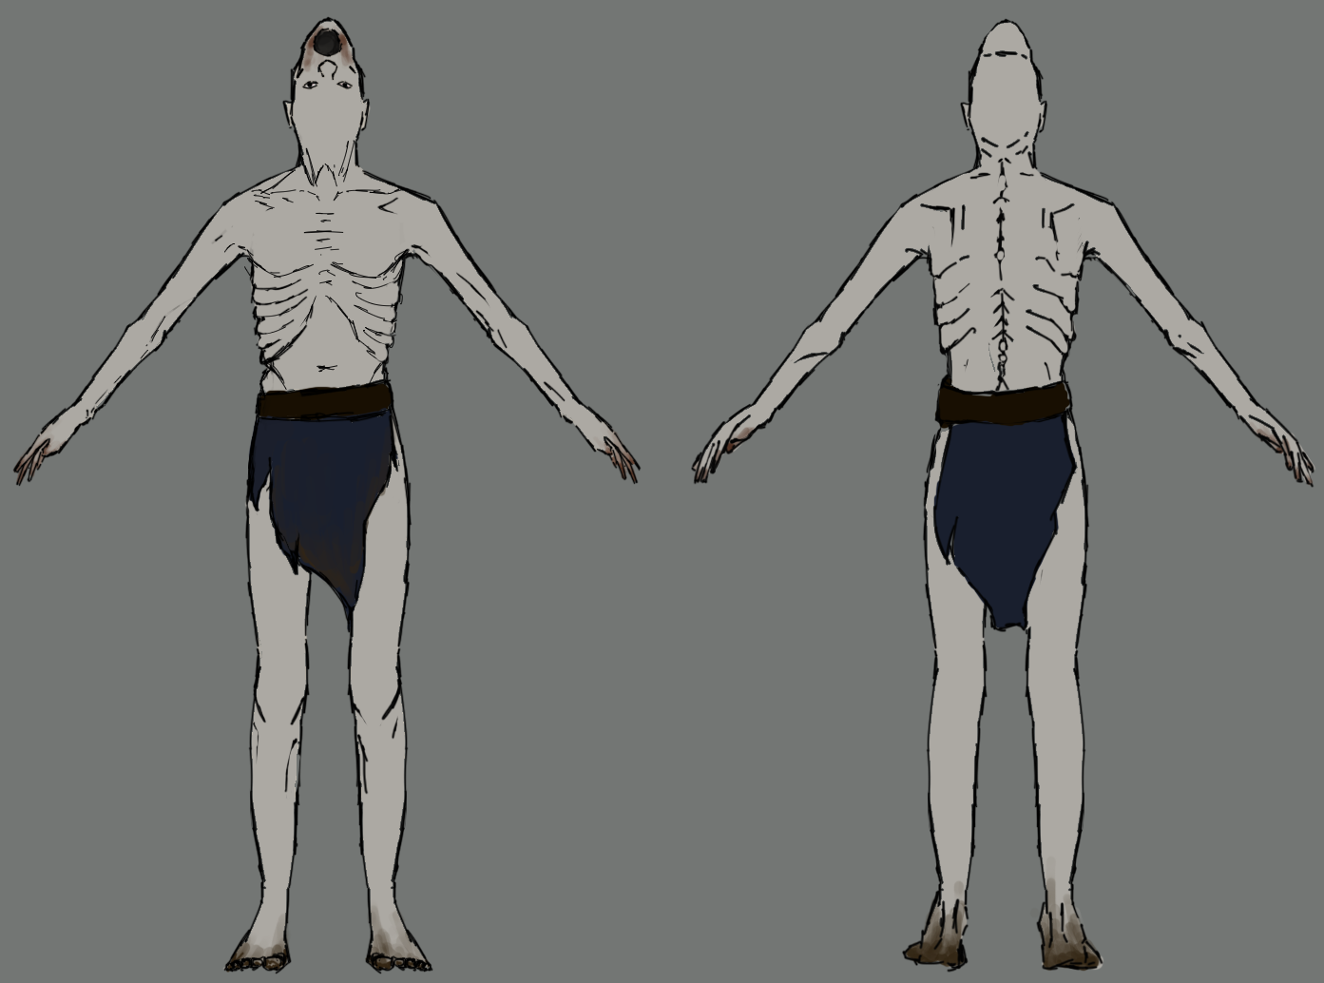
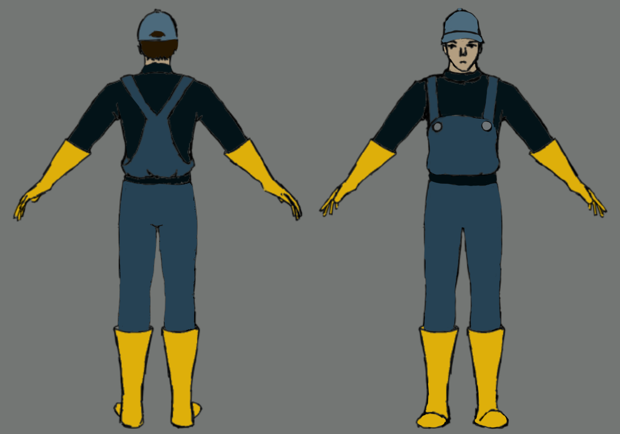
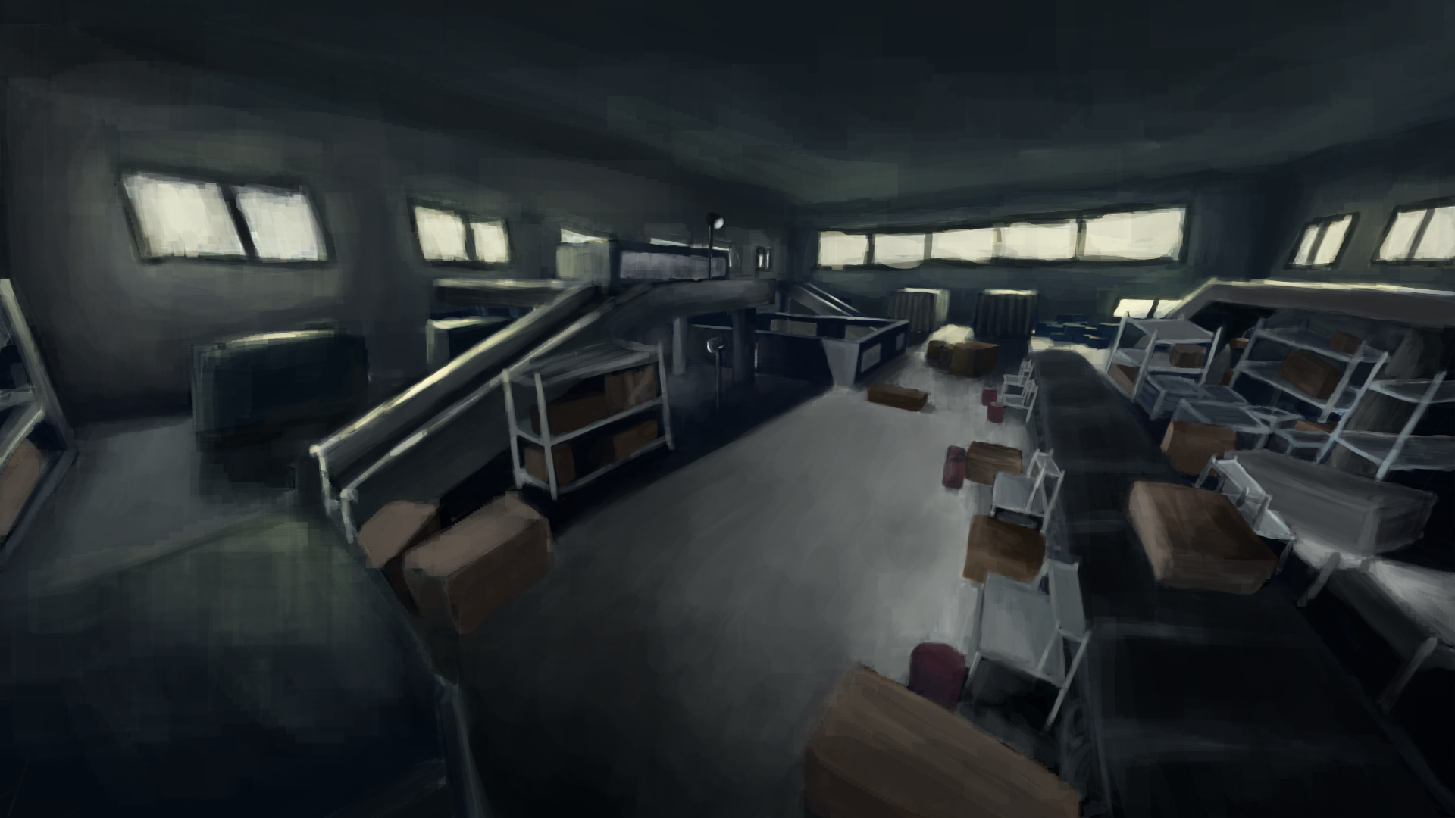
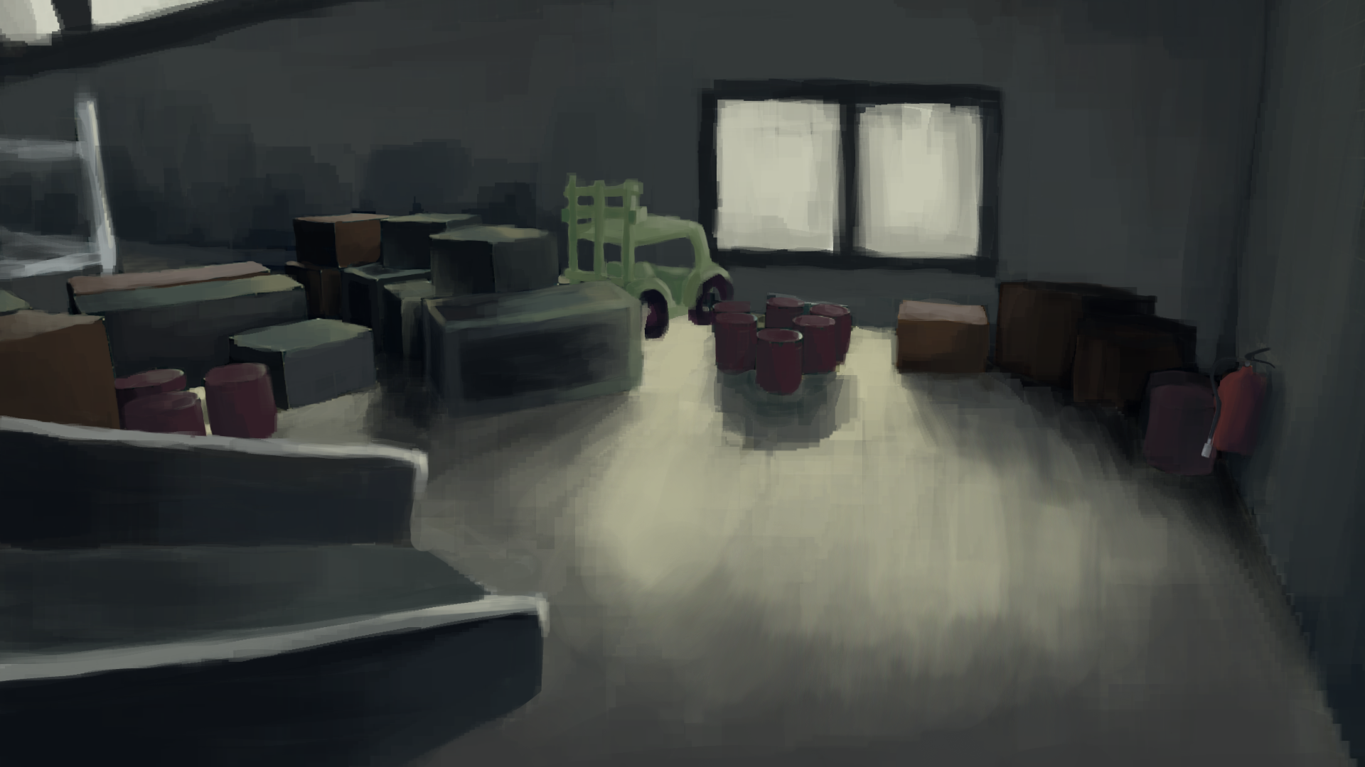
Concept Art

Slide 11
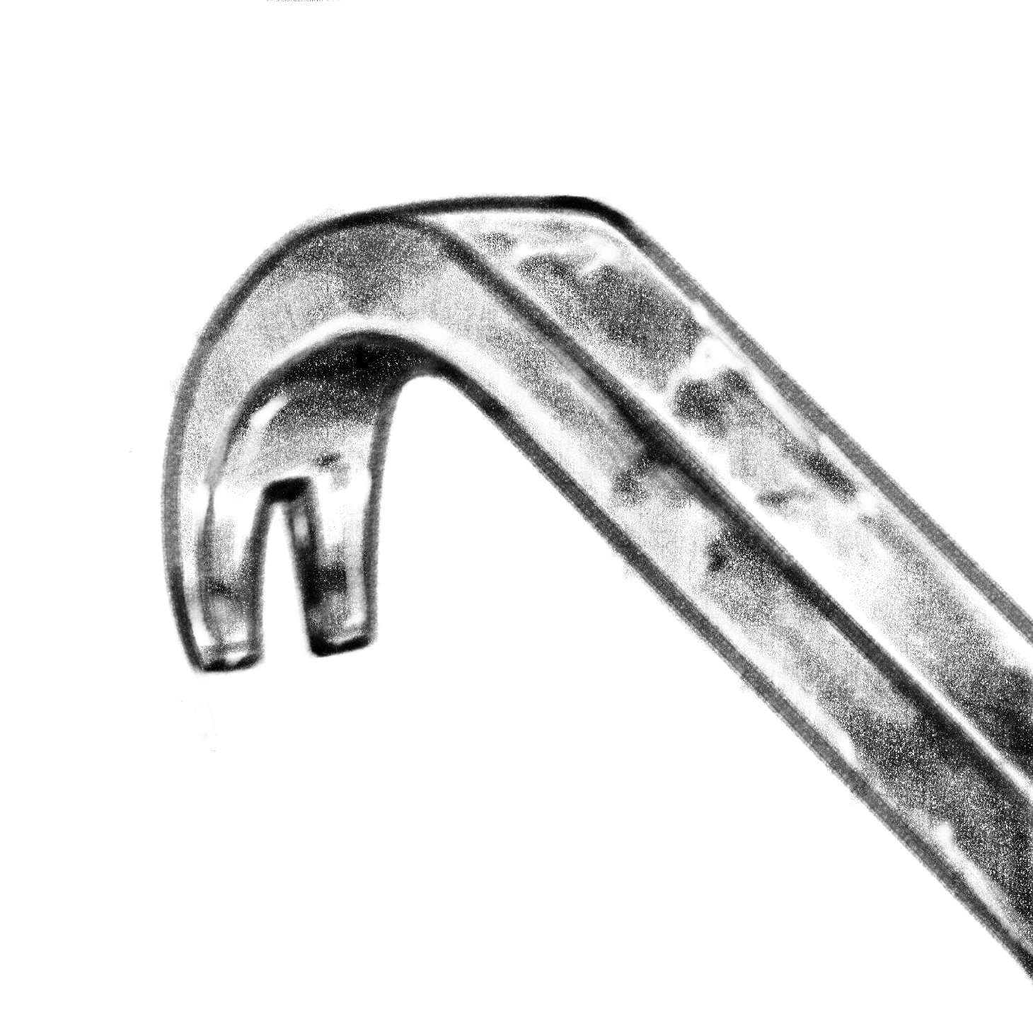
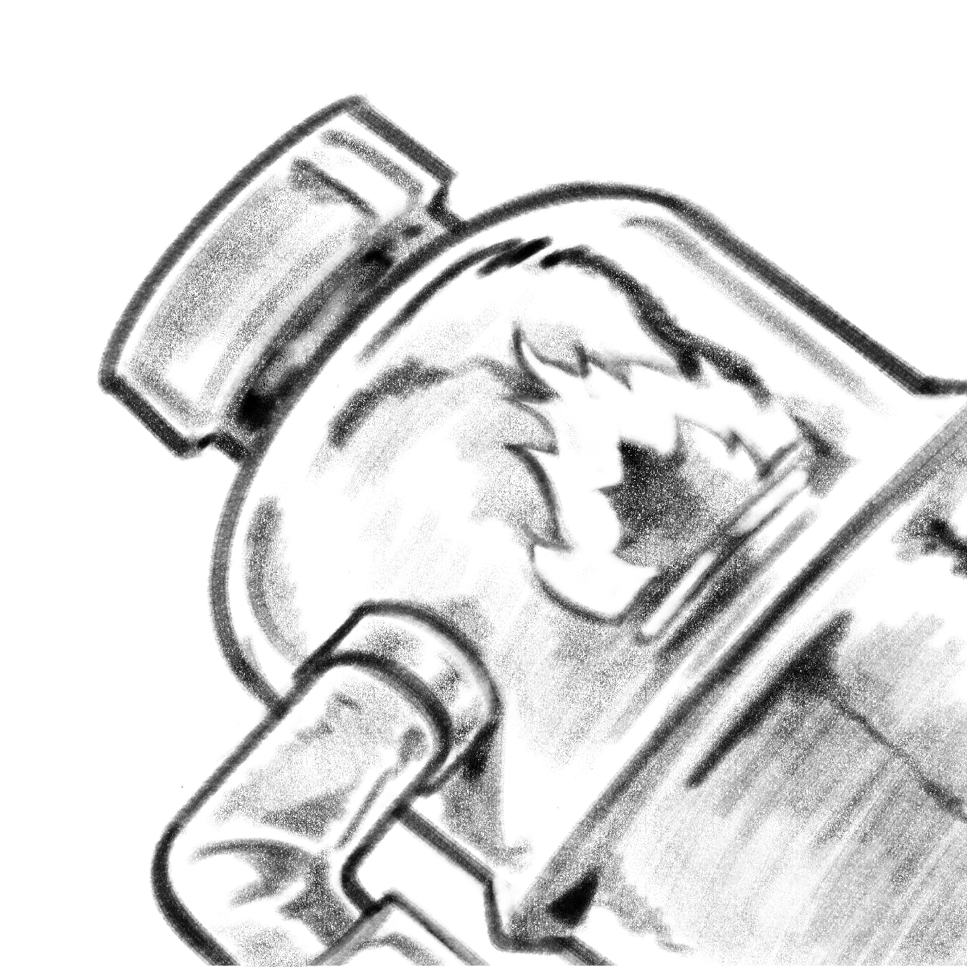
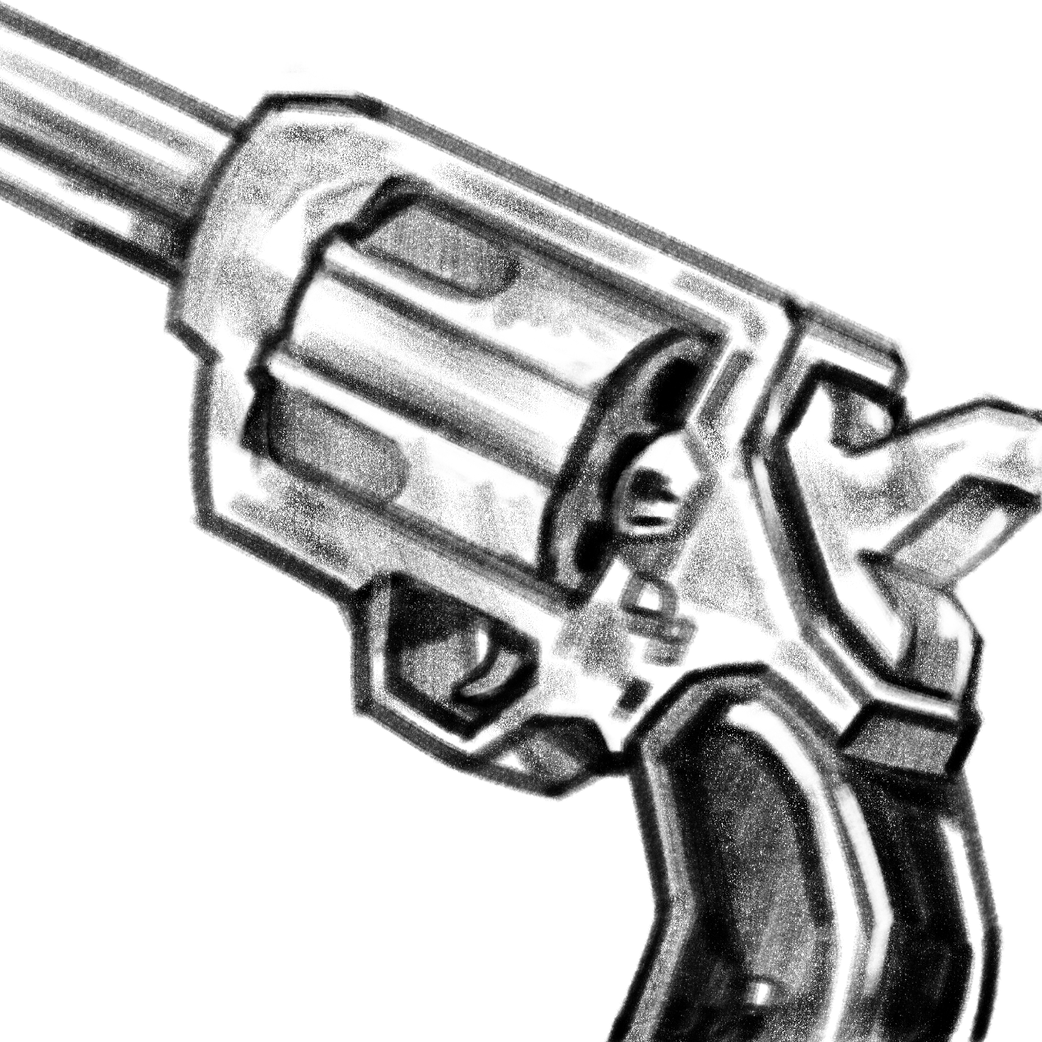
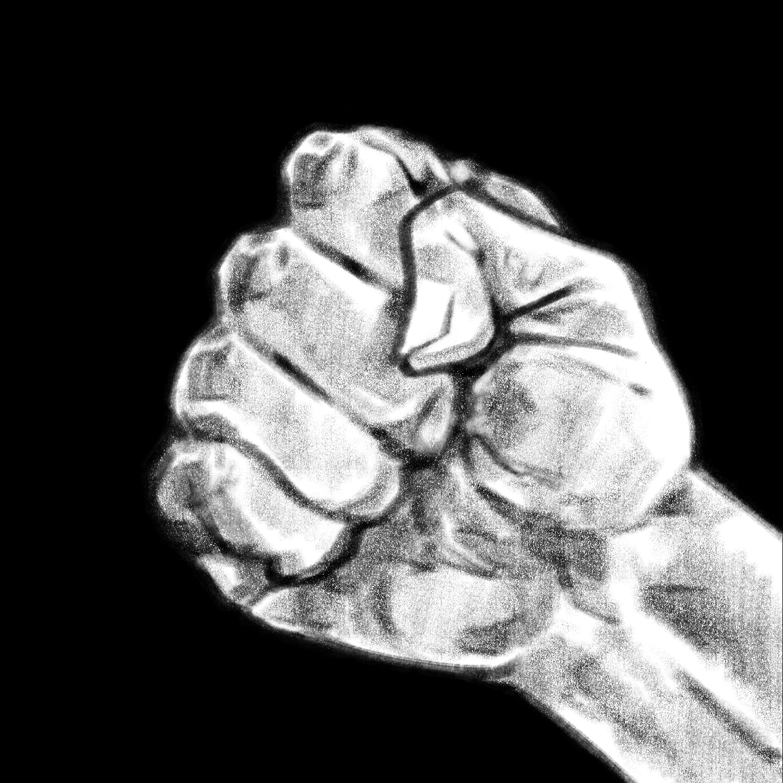

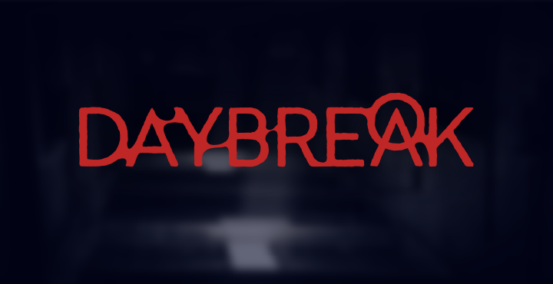
UI Elements

Slide 12
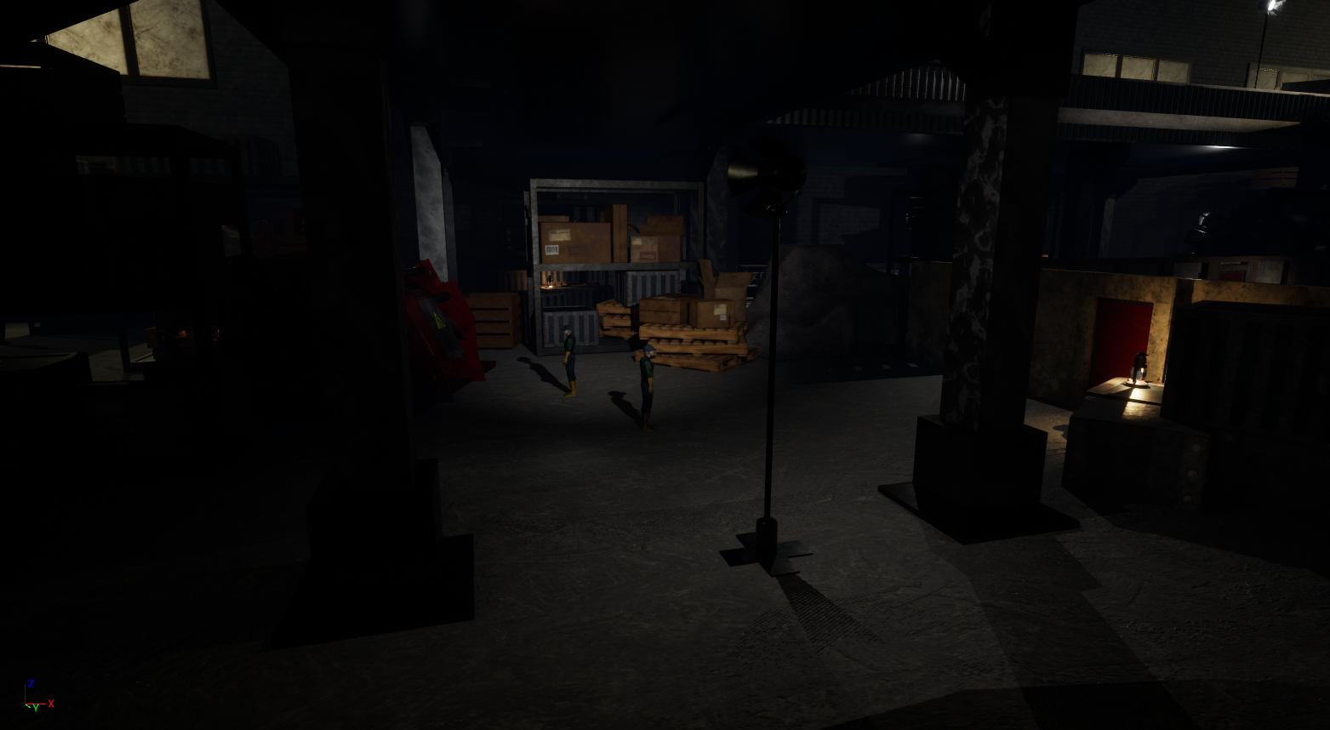
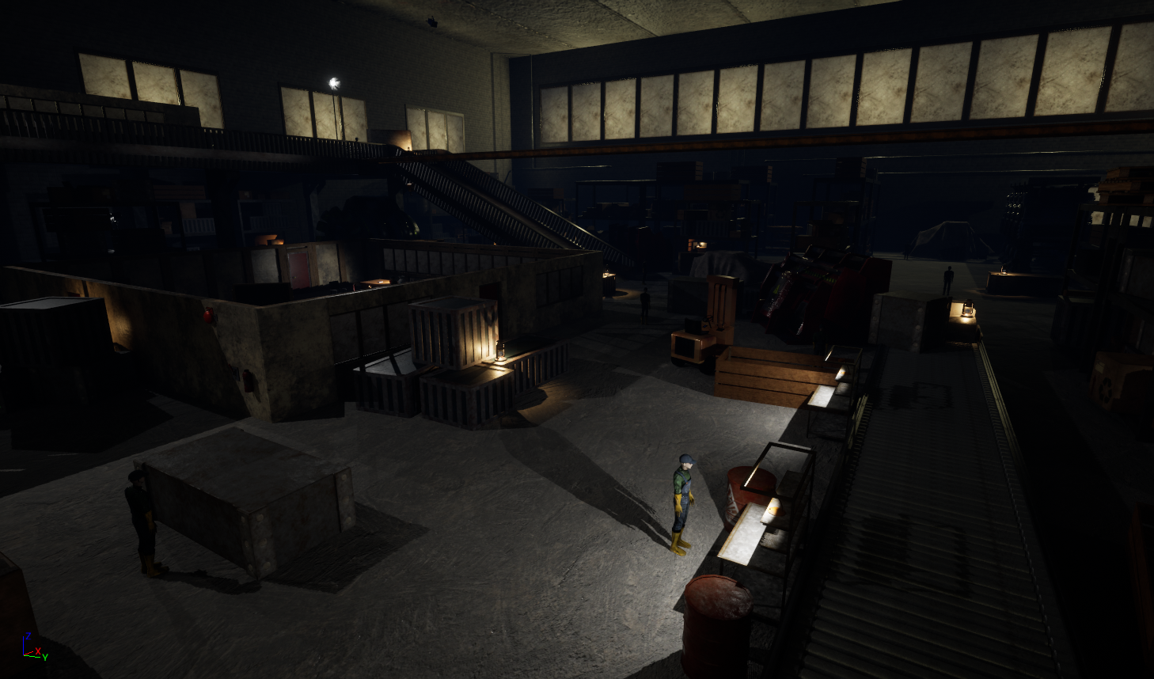
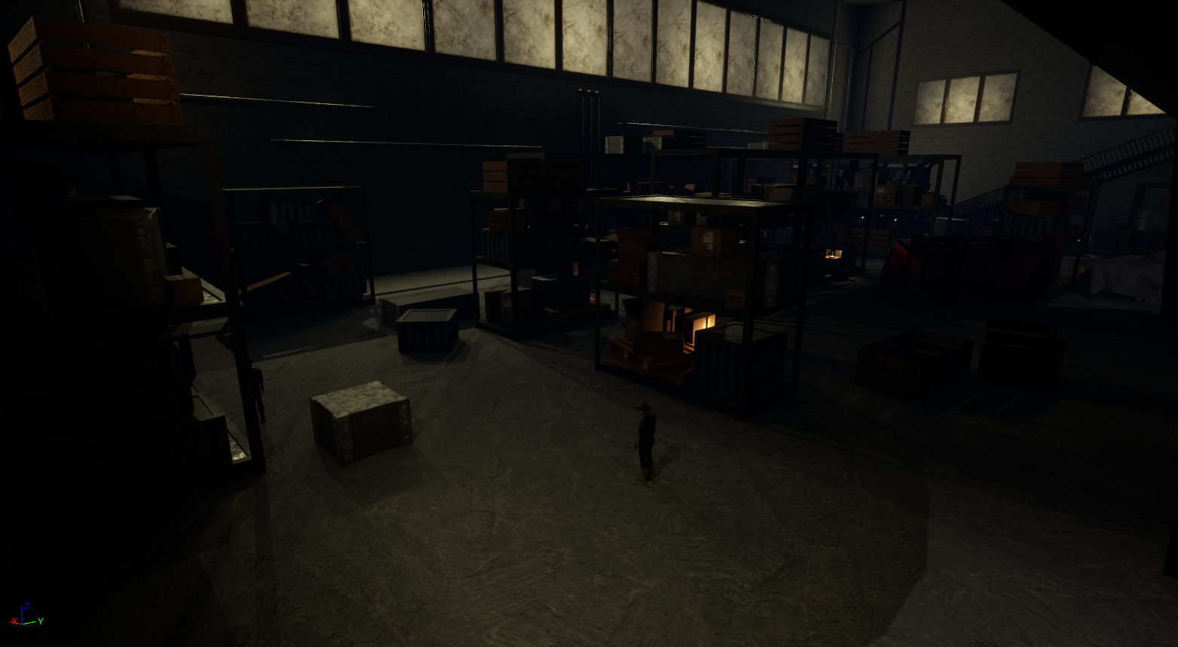
Final Level

Slide 13
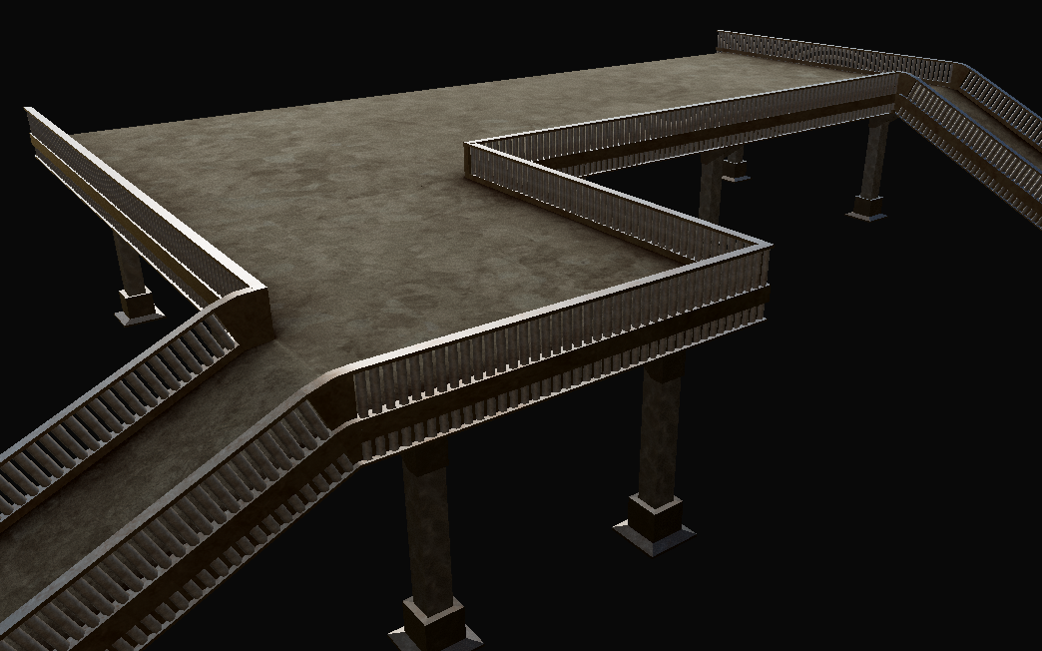
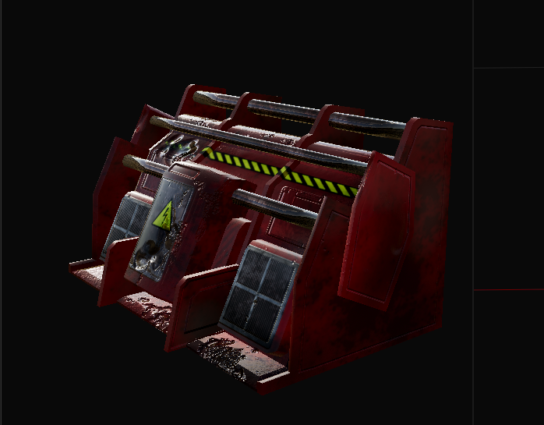
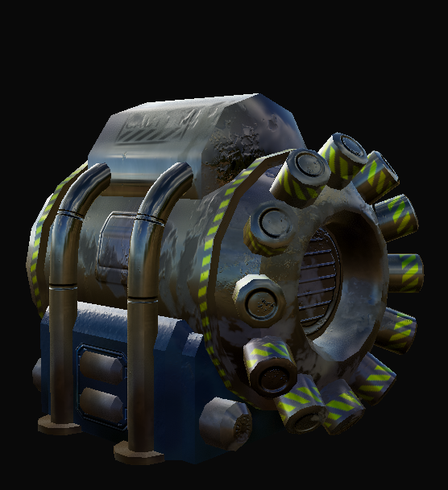
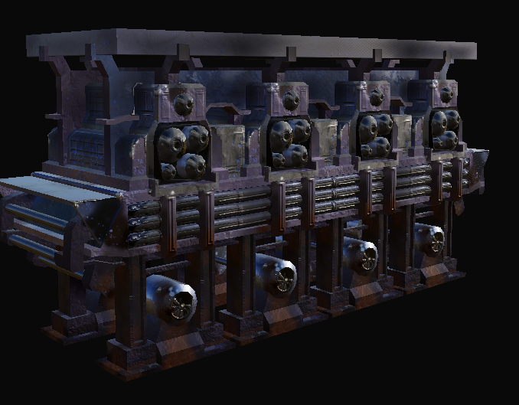
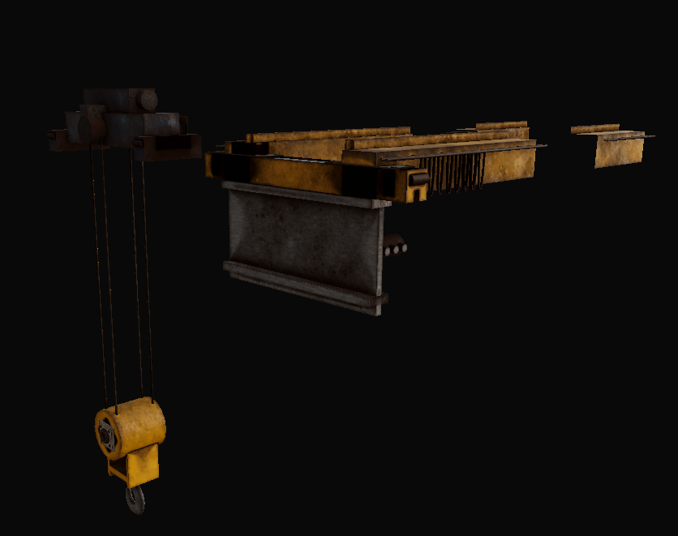
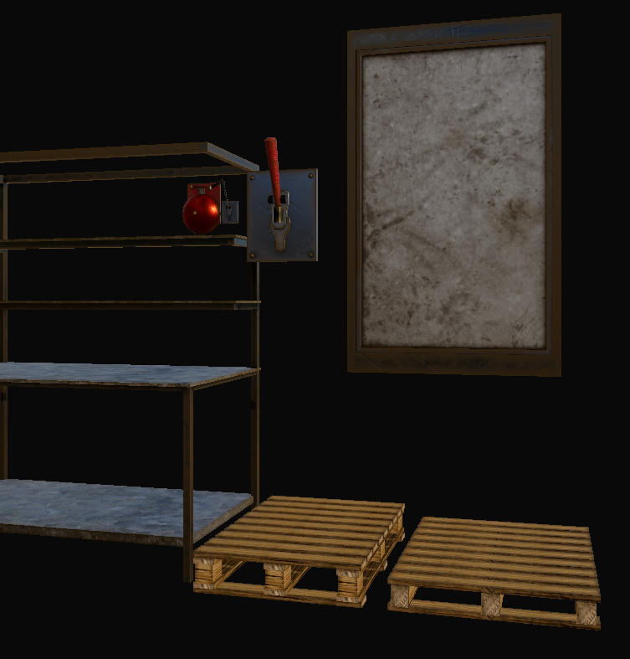
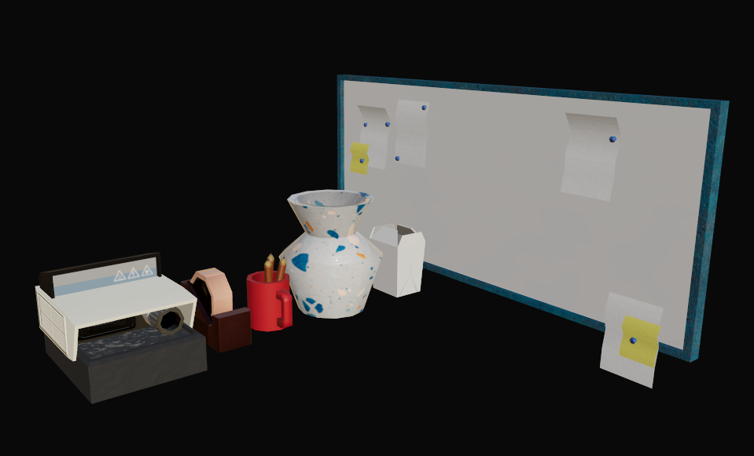
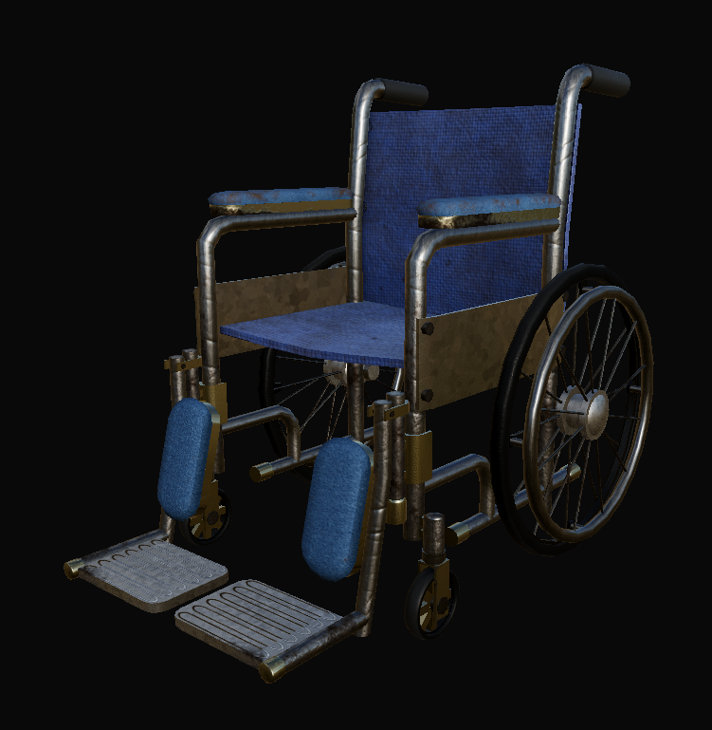
Models and Textures

Slide 14
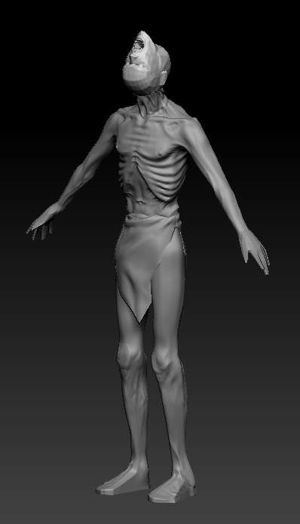
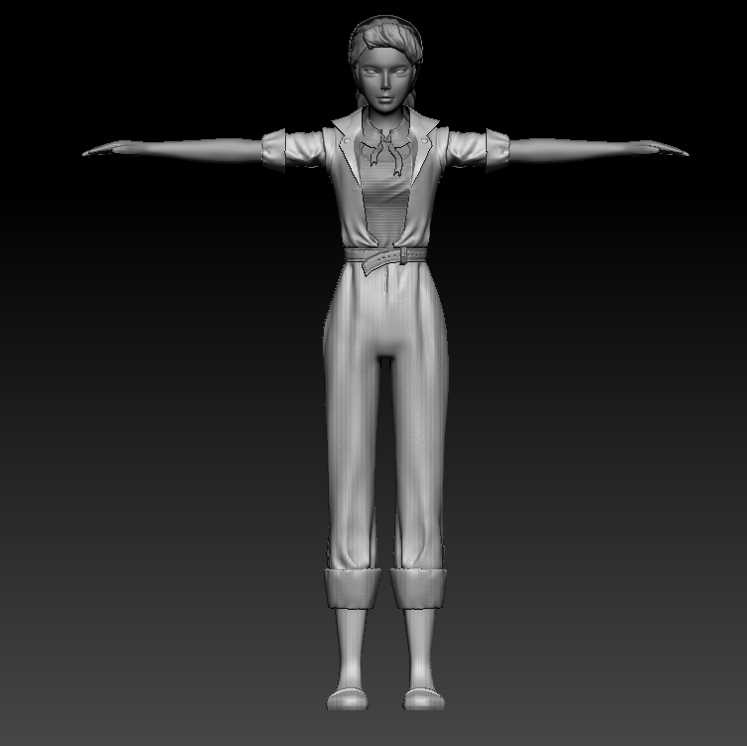
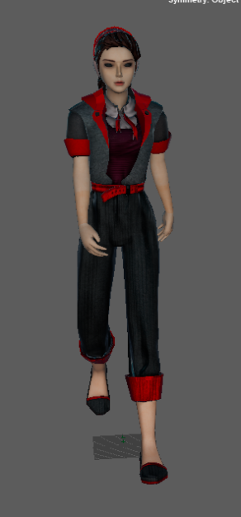
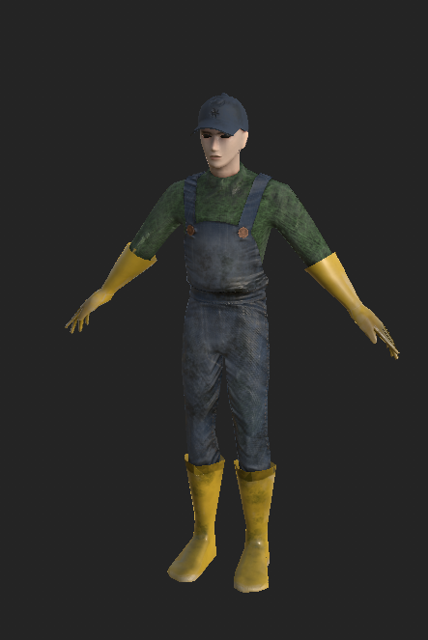
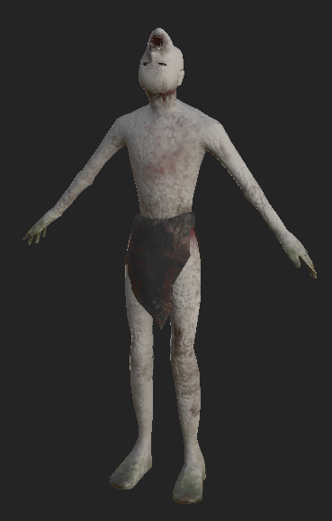
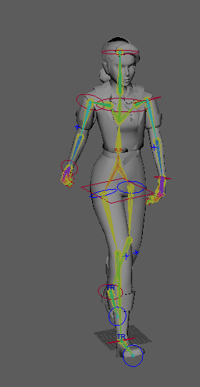
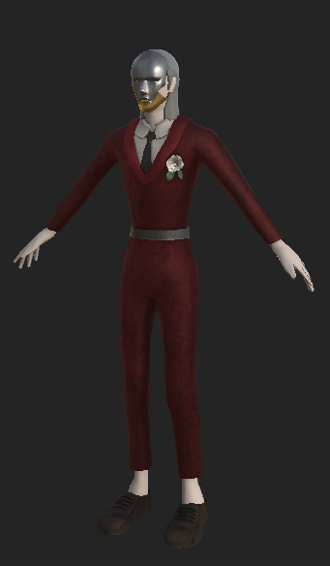
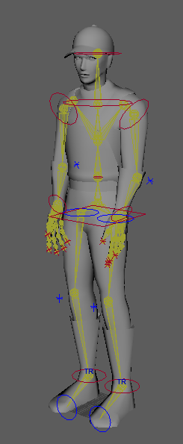
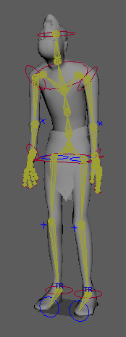
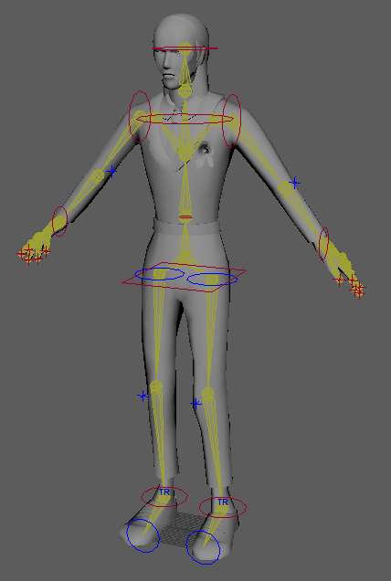
Models and Textures

Slide 15
Changes from proposal
Reduced Enemy and Player Interactions Outside of Combat
Failed to add Destruction Mechanics
Failed to add sound detection
Failed to add fire event
Failed to have a true killable objective

Slide 16
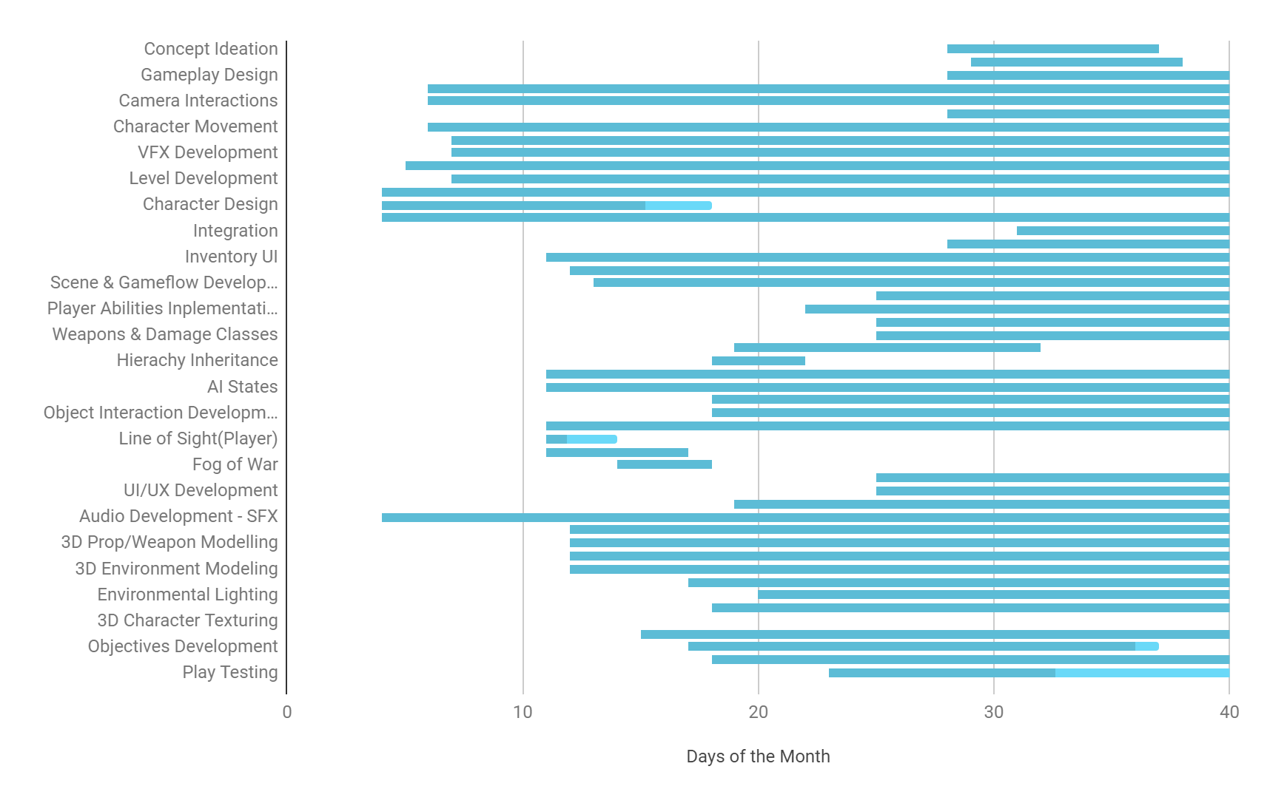
Gantt Chart

Slide 17
Learning Points
Winston
Learnt how to assign bones and bone references in skeleton mesh
Learnt how to handle animation based physics
Applied Behavior Tree and State Machine to AI
Created state tree with Environment Query System
Applied object oriented concepts alongside decorator and interface architecture design to behavior trees and entity control
Inventory items using modular architecture with equipment system
Unreal specific
Blueprints
Wire management
Abstract code such as interfaces and AI
Global references using singletons
Performance Bottlenecks
Replaced behavior tree and environment query system with self created system
Materials and Visual Effects, shaders and post process

Slide 18
Learning Points
Jiaxu
Unreal specific
Blueprints
Blueprint Interfaces
Wire management
Visual Programming
Niagara Effects
Material Creation
Post Process Material
Widget Functions
Making use of Datatables

Slide 19
Learning Points
Xin Ying
Learned how to use Substance Painter
Learned about materials and lighting in Unreal
Learned cloth simulation in Maya
Gained more experience with functional lighting
Gained more experience "decorating" levels when designing levels/environments

Slide 20
Learning Points
John Tan
Learned how to use Substance Painter at a very basic level.
Learned how to use Github at a very basic level.
Gained more experience drawing concept art.
Gained more experience with modeling efficiently in Maya in tandem with the UV unwrapping process. Understanding when to leverage height maps and textures to save on poly count.

Slide 21
Learning Points
Kerrin
Learned blendspaces and how they work in UE5
Learned how to code the animation blueprints to implement the animations into the game
Learned how to use Github
Learned how to use the Lattice tool in Maya to model different body shapes
Learned how to better use Substance Painter compared to the previous projects
Gained experience in sculpting different body types and anatomy plus different type of materials in Zbrush

Slide 22
Further Developments
Project under management and ownership of the team, alongside NYP School of Design. Further development to be carried out in the near future to package and ship product as a prototype.

Slide 23
Notable Mentions
GAME JAM
Winston
Unity animations
Unity physics
Player controls
Level Design/Generation
Sound Design
Jiaxu
Unity UI
Unity Mobile
Unity Player Pref
User Feedback
CORTUS
Most voted game
Trident
Yokawa Kazuya
Scenes, UI, Data management of Scores
Level Selection and global singletons

Slide 24
Thanks from:
DayBreak Team
GDT
Winston - Lead Programmer, Backend Dev
Jiaxu - Tech Artist, Frontend Dev
DGAD
Xinying - Art Lead,Level Designer
Kerrin - 3D Modeler, Animator
John - 3D Modeler. 2D Art, UI
Final Year Project of GDT/DGAD 2021

